Slide 1

2020 OHSBVA State Rules Clinic
Welcome!
Notes:
Welcome to the 2020 Ohio High School Boys Volleyball Association State Rules Meeting. My name is Lucas Tuggle, and I serve as the OHSBVA State Officials Coordinator.
I will be presenting this season’s rules interpretation clinic. But first, I’d like to thank Rick Puckrin for arranging and Walsh Jesuit for hosting tonight’s meeting.
Our goal here at the OHSBVA is for all officials across the state to hear the same message so, as our teams travel region to region, they are getting the same type of officiating, expectations and experience.
As we go through the presentation, should you have a question, please remember to write the question down. We’ll try to take questions at various times.
1

Slide 2
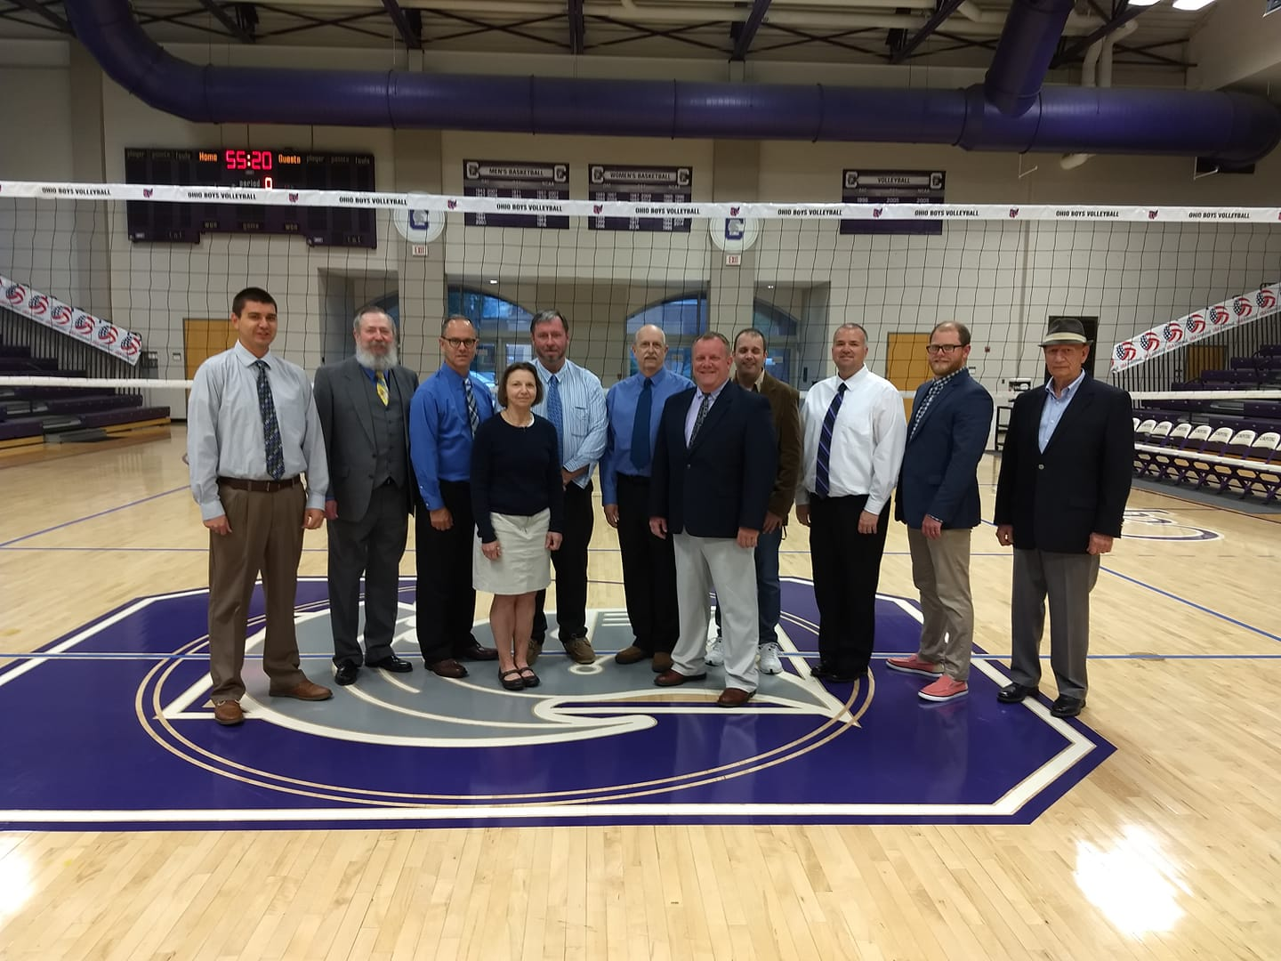
State Tournament Crew – 2019
Left to Right:
Lucas Tuggle (Head Referee),
Dan Litteral (Referee),
Dave McCray (Line Judge)
Mary Black (Referee)
Gerald Price (Line Judge)
Michael Chandler (Scorer)
Jeff Kline (Line Judge/Referee)
Brien Rife (Referee)
Shane White (Referee)
Drew Puckrin (Line Judge)
Steve DiBacco (Timer/Scoreboard Operator)
Notes:
Congratulations to the 2019 State Tournament crew. Our team this past June did a terrific job of facilitating matches and worked hard for our student-athletes.
Thanks to these individuals for their dedication to the OHSBVA and their hard work during the season.
And, congratulations and thanks to all officials who worked the post season last year. It was well deserved, and thanks for your service to the OHSBVA.
2

Slide 3
OHSBVA State Leadership
Executive Director:
  Gary Hajek
  garymhajek@gmail.com
Notes:
I always like to touch on the leadership for our organization. It is always a good reminder of who you may need to contact or of changes in leadership.
Our Executive Director is Gary Hajek. As Executive Director, Gary is in charge of the day-to-day operations of our organization.
Gary works with the OHSBVA Board of Directors, especially with our Board President, Craig Erford, who is also Head Coach of Archbishop Alter.
These individuals oversee the operation of our organization.
3

Slide 4
OHSBVA State Leadership
State Officials’ Coordinator and State Rules Interpreter:
Lucas Tuggle
lucastug33@gmail.com
740-815-7708
Responsible for improving officiating statewide
Works with lead coaches and officials
State Rules Interpreter
State Officials' Secretary (data management)
Head Referee/Evaluator at the State Tournament
Notes:
I am also part of the leadership team in my dual roles of State Officials Coordinator and State Rules Interpreter. I am responsible for leadership and training of our officials. In addition, I also serve as Head Referee at the State Tournament.
In my dual roles, I oversee all aspects of officiating for the OHSBVA. Should you have any questions during the season, please reach out directly to me or my staff and we will provide answers. Each region also has a Referee Coordinator who can answer questions or point you in the right direction.
4

Slide 5
OHSBVA State Officiating Staff
Assistant State Coordinator:
  Michael Chandler
  mchand1895@yahoo.com
    Responsible for:
    Training of officials
    Arbiter assigning system
    VolleyWrite Scoring System
Notes:
My staff includes Assistant Coordinator Michael Chandler, whose primary responsibilities include training of officials, the Arbiter assigning system and the VolleyWrite Scoring System used by many schools.
5

Slide 6
OHSBVA State Officiating Staff
Assistant State Rules Interpreter:
  Rick Brown
  rickmbrown721@yahoo.com
    Responsible for:
    Research
    Rules Interpretation
    Communications
    Officials’ Membership
Notes:
The next member of my staff is Assistant State Rules Interpreter Rick Brown, whose primary responsibilities include research, rules interpretation and communications. Rick is also responsible for the roster of officials, officials membership and other duties as assigned. Rick also serves as the Administrative Assistant to the leadership of the OHSBVA. Rules interpretation questions can be directed to either Rick or me.
6

Slide 7
OHSBVA Key Staff in Each Region
Referee Coordinator
Rules Interpreter
Regional Coach Representative
Notes:
Each Region has key support staff who provide leadership for that Region. Each Region has a Referee Coordinator, Rules Interpreter and Coach Representative. These are the key staff in the Region who work with me and my staff to address issues, training needs and to get consistent communications out to everyone.
7

Slide 8
OHSBVA South Region
Key Staff
Regional Referee Coordinator:
Tim Meyer, tmeyer917@yahoo.com
Regional Rules Interpreter:
John Love, jelove@fuse.net
Regional Coach Representative:
Matt McLaughlin, Head Coach
La Salle High School
Notes:
For the South Region, Tim Meyer is the Referee Coordinator, John Love is Rules Interpreter, and Matt McLaughlin, Head Coach of La Salle High School, is the Regional Coach Representative.
8

Slide 9
OHSBVA West Region
Officiating Staff
Regional Referee Coordinator:
Monique Huffman, VBRef@aol.com
Regional Rules Interpreter:
Mary Black, mblack50@woh.rr.com
Regional Coach Representative:
Matt Butler, Head Coach
  Middletown High School
Notes:
For the West Region, Monique Huffman is the Referee Coordinator, Mary Black is the Rules Interpreter, and Matt Butler, Head Coach of Middletown High School, is the Regional Coach Representative.
9

Slide 10
OHSBVA East Region
Key Staff
Regional Referee Coordinator:
Jim Hammar, columbusref@yahoo.com
Regional Rules Interpreter:
Michael Chandler, mchand1895@yahoo.com
Regional Coach Representative:
Herb Sharfenaker, Head Coach
Columbus Briggs High School
Notes:
For the East Region, Jim Hammar is the Referee Coordinator, Mike Chandler is the Rules Interpreter, and Herb Sharfenaker of Columbus Briggs High School is the new East Coach Representative.
10

Slide 11
OHSBVA North Region
Key Staff
Regional Referee Coordinator:
Rick Puckrin, mpuck05@yahoo.com
Regional Rules Interpreter:
Brien Rife, bri ri@yahoo.com
Regional Coach Representative:
Larry Meehan, Head Coach
  Hudson High School
Notes:
For the North Region, Rick Puckrin is the Referee Coordinator, Brien Rife is the Rules Interpreter, and Larry Meehan, Head Coach of Hudson High School, is the Regional Coach Representative.
11

Slide 12

THE OVR –
CORPORATE SPONSOR OF THE OHSBVA
Notes:
I want to thank the Ohio Valley Region of USA Volleyball who is our continuing corporate sponsor.
Without the support we have received from the OVR, our progress as a high school sport would not have been possible. The OVR has been a major supporter of the OHSBVA for many years, and its financial support has been instrumental in professionalizing and broadcasting our State Tournament.
If you see any of the Board of Directors from the OVR, please thank them for their contributions to the OHSBVA.
12

Slide 13
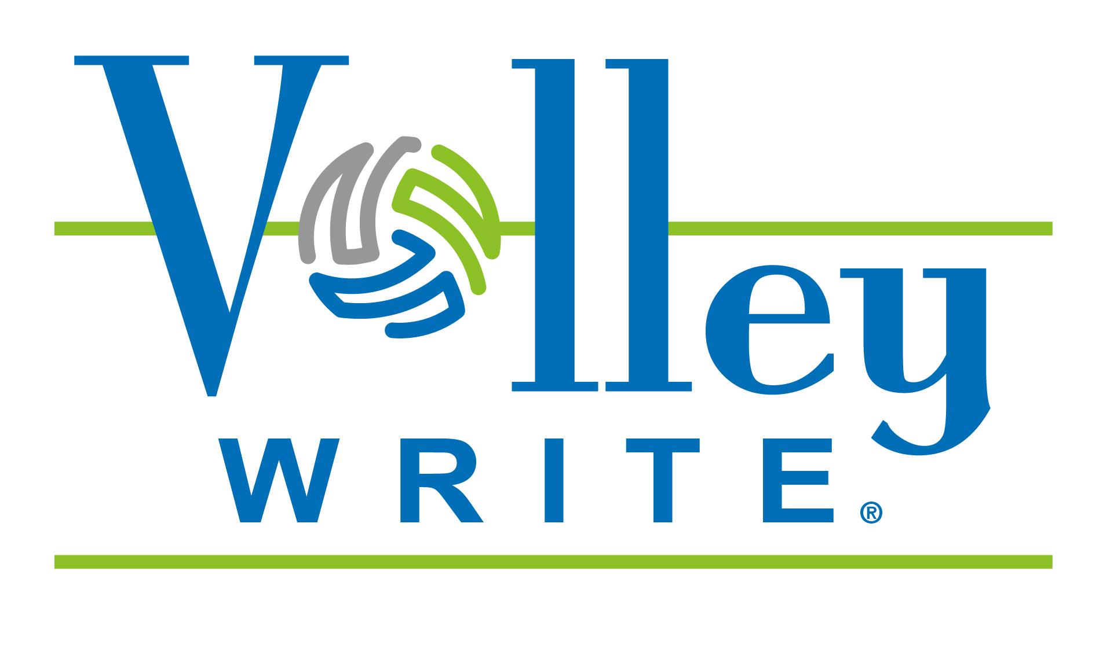
Notes:
As an OHSBVA referee, you are likely to work matches in which electronic scoring rather than paper scoring is used. The OHSBVA has endorsed the VolleyWrite Scoring System software which is also used to score both the OHSBVA and OHSAA State Tournaments.
As such, you need to familiarize yourself with how the software works and how to work with a VolleyWrite Scorer and spotter just as you would with working with a Scorer and Libero Tracker using paper scoring.
13

Slide 14
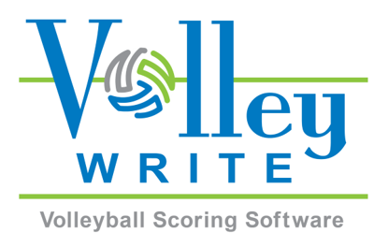
OHSBVA
Partners with
VolleyWrite
How does VolleyWrite help?
Scorekeeping/libero tracking input is simplified, so you can keep your attention on the court.
The rules are built in, and illegal actions are noticed right away.
You don’t have to know scoring notation.
VolleyWrite can e-mail match results automatically.
Volunteers will actually want to keep score.
How to get more information:
Visit their website at www.VolleyWrite.com.
The VolleyWrite YouTube channel has instructional videos to show you how to use it.
The software includes help files which you can access from inside VolleyWrite using the round question mark button in the top right corner of each tab.
Windows Version:
A season license lasts 6 months and costs only $49.99. Purchase a Windows license at www.VolleyWrite.com.
iPad Version:
VolleyWrite is available for the iPad through the App store. A one-week initial license is available for $0.99 and a season license is $49.99.
New programs will be able to request a free key via an e-mail message to Info@VolleyWrite.com
www.VolleyWrite.com P.O. Box 11370, Cincinnati, OH 4521 (513) 400-5937
Notes:
The VolleyWrite Scorer whom you encounter at your match can become your best friend in helping a match go well and flow relatively quickly! The key is your ability to work to maximize that person’s value to you.
Regardless, the OHSBVA follows the OHSAA requirement that a VolleyWrite Scorer has a spotter to help identify the movement on and off the court of both teams’ libero players and to call out substitutions for both teams. If a trained spotter is not available, the Timer/Scoreboard Operator may assist in calling out libero replacements and substitutions. This is not as good as having a dedicated and trained spotter, but it is acceptable and matches the realities at some sitess.
Two points of emphasis: First, it is difficult to work with a system with which you have no experience. Therefore, familiarizing yourself with how VolleyWrite works makes good sense; it can help create greater comfort for you as a second referee in working with a VolleyWrite Scorer. A free “trial” short-term license is available by reaching out to VolleyWrite.com.
Second: review the document on ohioboysvolleyball.com/Officiating entitled “How to Work with a VolleyWrite Scorer and Spotter” to get a handle on what questions to ask in preparing to partner with a VolleyWrite Scorer AND what help you can receive to help make your job as a second referee/R2 easier!

Slide 15
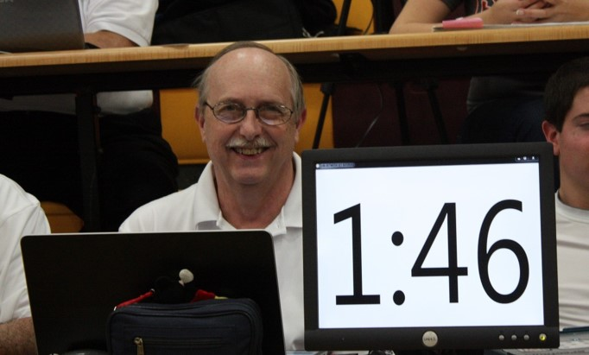
VolleyWrite Assistance and Contact Information
Contact
  VolleyWrite.com
  (513) 400-5937
OHSBVA go-to person:
  Michael Chandler, mchand1895@yahoo.com
Notes:
For guidance with VolleyWrite, reach out to our Assistant State Coordinator and VolleyWrite guru, Michael Chandler, or – especially in the South and West Regions – to Debbie Keller of Wildfire Sports, who partners with Michael Chandler and is the owner of the VolleyWrite Scoring Software program (dkeller@volleywrite.com).
15

Slide 16
NFHS Volleyball Rules
OHSBVA primarily follows NFHS rules but some rule differences and mechanics differences
OHSBVA allows some different techniques that are considered “best practices” in officiating
Annual refresher on rule differences between boys’ and girls’ high school volleyball rules is important
Notes:
Now, lets look at our rule differences and administrative modifications.
The OHSBVA uses NFHS Volleyball rules with two exceptions. You can find a list of Administrative and Rule Modifications as well as Techniques, Mechanics and Procedures for Match Administration under the “Officiating” tab (left-hand menu) on our website, www.OhioBoysVolleyball.com.
These training documents reflect some best practices that the OHSBVA follows to facilitate matches and make them all about the players.
Since many OHSBVA referees also officiate under OHSAA, USA Volleyball and/or college women’s/men’s volleyball rules, remembering which rules to follow for boys’ high school volleyball can be a challenge.
We want to emphasize the importance of reviewing our rules and mechanics before the start of each season.
16

Slide 17
OHSBVA Rule Differences
What is considered a center line fault?
What is considered a net fault?
Notes:
We have two rule differences from NFHS rules which also govern OHSAA girls’ high school volleyball. Let’s review these differences:
What is considered a center line fault?
Our center line rule is partly the same as the girls’ rule.
The common part is that a player’s foot touching the opponent’s court on a live ball is ALWAYS considered a center-line fault unless part of that foot is also on or over the center line AND there is no interference with the opponent.
The OHSBVA modification is that a player touching the opponent’s court on a live ball with any other part of the body is NOT a fault in the following instances:
IF there is no safety hazard posed by the contact with the opponent’s court AND IF there is no interference with the opponent’s ability to make a play including the next play on the ball or get into hitting or defensive position, then no fault has occurred.
HOWEVER, other than if contact is with a foot or feet as described above, the default call for contacting the opponent’s court on a live ball is a center line fault. So, foot down and not on or above the line is an automatic fault call; there is no judging a safety hazard or interference. Those judgments are made only for other parts of the body penetrating the opponent’s court. IF there is no safety or interference concern, then play may continue without a fault being whistled.
What is considered a net fault?
Now let’s take a look at our rule difference as it relates to net faults:
As with girls’ high school volleyball, a net fault occurs on a live ball when a player initiates contact with the net including the antenna for the full length of the net from post to post other than with hair. Net contact caused by the ball driving the net into a player is not a fault. Hitting only the pad that covers the post is also not a fault. Any body part, jersey or shorts contacting the net would be a fault. However, for OHSBVA, loose clothing like a jersey or shorts contacting the net is not considered a net fault.
17

Slide 18
OHSBVA Administrative Modifications
Which coaching staff may stand, where and when may they stand?
After yellow or red card issued to member of coaching staff/bench personnel, may a coach stand to coach the team?
Notes:
We also have some administrative modifications from OHSAA volleyball that the coaches have approved.
Which coaching staff may stand, where may they stand and when may they stand?
The first modification I want to address involves “which coaching staff may stand, where may they stand and when may they stand?”
The OHSAA allows only the head coach to stand to coach the team on a live ball or a dead ball. The OHSBVA has modified this with a more liberal approach:
First, any coach – but only one coach – may stand on a live ball in a non-disruptive manner to coach the team, within the Libero Replacement Zone and no closer than 6 feet from the bench sideline and without blocking the view of the second referee or bench-side line judge. The standing coach does NOT have to be the head coach. If an assistant coach is standing, the assistant coach may not request time-outs or substitutions. That responsibility belongs to the head coach. And, yelling across the court is considered disruptive coaching.
On a dead ball, ALL coaches may stand to coach the team as long as all but one coach are being seated when the R1 is preparing to authorize service. The key here is that coaches returning to the bench should not delay the flow of the match in terms of the timing with which the R1 authorizes service for the next rally.
After a yellow or red card is issued to a member of the coaching staff or bench personnel, may a coach stand to coach the team?
Cards that are issued during a match do not prevent a team from continuing to have a coach stand and coach the team during a live ball or from all coaches being able to stand to coach the team on a dead ball. However, we need to emphasize that sanction cards are progressive and they apply for the match. Coaches risk additional cards for continued unsporting conduct.
18

Slide 19
OHSBVA Administrative Modifications – Continued
The red/white/blue Model V5M5000 Molten Flistatec Volleyball is to be used for all OHSBVA tournament matches
Players may participate in no more than six (6) sets against a common opponent (same school) on a given play-date
Notes:
The red/white/blue Model V5M5000 Molten Flistatec Volleyball is to be used for all OHSBVA tournament matches.
Teams are encouraged to use the Molten V5M5000 volleyball (red/white/blue OR red/white/green) for regular-season matches.
The red, white and blue version is required for all post-season matches.
However, for regular-season matches, the OHSBVA allows any volleyball with an NFHS authenticating mark to be used for a match if the ball is in good condition. The referees determine ball condition and are encouraged to secure other better volleyballs if the game balls presented by the home team are of questionable condition. It is advisable to have a back-up ball in good condition from the same manufacturer and the same color combination.
Players may participate in no more than six (6) sets against a common opponent (same school) on a given play-date.
Players have no more than six set participations available when playing a common opponent on the same play-date. This means that counting Freshman and Junior Varsity set participations with School “A” playing School “B,” a player who enters a set in the Varsity match with a rally played may not have this be the player’s 7th set of participation on that date.
19

Slide 20
OHSBVA Administrative Modifications – Continued
Players may change shirts without leaving court area
Substitutes do not have to sit on the bench but may not stand in front of it
Substitutes and team’s coaching staff may stand outside team benches in line with benches/chairs without being disruptive or interfering with play
Notes:
The OHSBVA has not adopted the NFHS rule that penalizes players who change their shirts court-side with an unsporting conduct card issued to the head coach. Again, players may change their shirts with no penalty.
In addition, subs are not required to sit on the team bench but may not stand in front of it other than for short instruction. Instead substitutes and any of a team’s coaching staff are permitted to stand outside team benches (typically chairs) in line with the benches/chairs as long as they are not disruptive.
This is an option for teams; they still may choose to sit. If they do stand, the rule prohibiting players from standing in front of the chairs should still be enforced.
Coaches and assistant coaches may stand in this area as well. Coaches standing outside the team benches should not be disruptive and should not use this area to help officiate the match. This area for coaches should be use to coach their teams.
20

Slide 21
OHSBVA Administrative Clarification – Continued
How many volleyball matches may be played by a school on a single date of play?
  The OHSBVA follows the OHSAA’s rule that limits schools (by level of play) to THREE (3) matches on a single play-date
Notes:
The OHSAA has a rule that precludes schools from playing more than 3 best-of-3 OR best-of-5-set matches on any given play-date.
The OHSBVA has NOT created an administrative modification to this OHSAA rule.
This rule applies to Middle School, Freshman, Junior Varsity AND Varsity teams.
21

Slide 22
Review of Major 2019 Rule Change
Libero jersey must meet standard of being “clearly contrasting from all angles”
When jersey contrast marginal in terms of legality, referees ask coach to produce a compliant jersey
If coach does not have a more clearly contrasting jersey but the referees can live with libero jersey for this match, they should “play and report”
If coach does not have not another libero jersey and jerseys are clearly not contrasting, team plays with no libero
Notes:
The OHSBVA adopted one major rule change last season:
Following the other major rule-sets, the OHSBVA abandoned the solid-colored jersey rule. We replaced this rule by going back to the previous requirement that libero jerseys be “clearly contrasting from all angles” from jerseys worn by their teammates.
We asked referees to view both teams’ libero jerseys as early as possible to verify compliance and, where there was an issue, to work with the coach to try to get a better jersey for the libero. This is the game plan both when a libero jersey is marginally contrasting and where it is clearly non-contrasting.
This gives the coach an opportunity to put the team’s libero into a jersey that contrasts better with the regular team jerseys and helps referees, scorers and libero trackers in their efforts to properly track the liberos.
Only where a libero jersey is really non-contrasting would a coach have to find a compliant jersey or play without a libero. When there is marginally contrasting libero jersey, work with the coach to fix the issue.
When there is an issue with a libero jersey not being clearly contrasting but the team is allowed to play with the libero wearing that jersey because there is no better jersey available, the referees are expected to share that another set of referees may not allow the libero to play in that jersey combination.
However, if the jersey combination is clearly non-compliant and the team cannot produce a compliant jersey, the team plays without a libero.
Regardless, when there is an issue with a libero jersey – whether or not the libero changes to a better compliant jersey – the R1 should report the problem to me to allow proactive handling and prevention of further issues.
22

Slide 23
Rules and Mechanics Changes for 2020
The OHSBVA typically adopts NFHS rule and mechanics changes after a careful review of information published initially in early February
This review allows the OHSBVA to implement some changes that are viewed as beneficial to the boys’ game while waiting for additional clarification of other changes from the NFHS
Notes:
There are a number of changes for the upcoming season, some of which simply involve clarifications from the 2019 NFHS rule changes that we were not able to share at last year’s rules meetings.
23

Slide 24
Rules and Mechanics Changes for 2020
Clearly Contrasting Libero Jersey Predominant Colors
Notes:
We know the libero jersey must be clearly contrasting from his teammates’ jerseys from every angle.
The key is ensuring the ability of everyone with a responsibility to be able to quickly identify the libero.
The R1, R2, Official Scorer and Libero Tracker all have to be able to quickly spot the libero on the court.
The new rule clarifications that were issued after the start of last year’s boys’ season involve what constitutes predominant colors on regular team jerseys and what the libero may and may not wear as predominant colors on his jersey.
Each libero’s jersey has to be clearly contrasting from the predominant color or colors of the regular team jerseys including sleeves. Trim, accent colors, collars and piping are not to be considered in determining predominant colors.
The libero’s jersey can’t be comprised solely of the same predominant colors worn by his teammates even if these colors are placed differently on the uniform top.

Slide 25
Rules and Mechanics Changes for 2020 – Continued
Clearly Contrasting Libero Jersey Single Predominant Color
Notes:
It’s relatively simple when there is a single predominant color compared with multiple predominant colors. We typically see jerseys with a single predominant color.
A predominant color is one that makes up about half of the jersey top.
Referees should view jerseys for both teams as soon as possible to determine if there is a libero compliance issue.
To be easily distinguishable, the libero jersey should consist of relatively little of the predominant color of the regular team jerseys.
Whenever there is an issue about a predominant color and/or whether a libero jersey is clearly contrasting, referees need to come to an agreement.

Slide 26
Rules and Mechanics Changes for 2020 - Continued
Clearly Contrasting Libero Jersey Multiple Predominant Colors
Notes:
When uniform tops have two colors that comprise about half the color of the jerseys, both of these colors are considered predominant colors.
This means the team’s libero jersey can’t have either color as a predominant color regardless of where the predominant color is placed.

Slide 27
Rules and Mechanics Changes for 2020 – Continued
Side-Folding Retractable
Backboard over Playable Area
Notes:
We received clarification for situations where backboards are raised from vertical over a playable area. Some backboards fold sideways instead of being raised from a vertical position to a position near the height of the ceiling. In the past, we struggled with what ground rule to establish for a ball contacting such a backboard. Now, we do not care whether a backboard is raised only partially.
Even though it is still technically vertical, a side-folding retractable vertical backboard raised to the side and only partly up toward ceiling is considered to be an overhead obstruction. A ball striking a raised backboard remains in play provided the ball does not cross the plane of the net to the other side and is next played by a teammate, regardless of how the backboard is raised or how minimally past vertical the backboard is raised.
Since these backboards are considered overhead obstructions , when a first or second contact with the backboard occurs by the team that last played the ball – assuming that part of the backboard is over a playable area – play continues. There is no replay option.
We are also reminded that a service toss cannot touch a partly retracted OR fully retracted backboard without a fault occurring, the same as with a vertical/down backboard. Signal 13 (Out of Bounds) is used.

Slide 28
Rules and Mechanics Changes for 2020 – Continued
Roster Procedural Changes
Notes:
We have a new procedure in terms of the timing of coaches submitting rosters and a clarification in the newly announced new rule changes.
First, the rosters for both teams are due at the pre-match meeting with coaches and captains rather than at the 10-minute mark on the countdown clock during a typical warm-up. In addition, rosters are to be handed to the R2 at the pre-match meeting and not to the Official Scorer or left on the officials’ table.
Failure to timely submit a roster was to be penalized with a loss of rally and point to the opponent, but the NFHS has wow changed this to an unnecessary delay (administrative yellow card).
The intent of the most recent change is to eliminate a double penalty (two points) for a late roster submission and the roster is also incorrect and has to be changed. The NFHS did not want to start a match by assessing two points to the opponent for a coach’s clerical error.
I do NOT want us to penalize a coach PERIOD for forgetting that the roster is now due at the pre-match meeting. The R2 simply makes sure the coach goes and gets the roster and hands it in. It may simply be an issue of the coach having left it at the bench or, out of habit, left it at the table. I want us to educate and facilitate rather than penalize.
A couple of other issues with the change in timing. With rosters now due at the pre-match meeting, if the warm-up is 10 minutes or less, when the roster is turned in at the pre-match meeting and the clock is started, the roster may not be changed without penalty other than for blood on a jersey or a torn jersey. Don’t be too tough on this. If the coach identifies a problem after the clock has started, if it’s a short time, try to find a way not to penalize.

Slide 29
Rules and Mechanics Changes for 2020 – Continued
New Informal Signals for
Legal Back-Row Attacks
Notes:
We now have two new informal signals to be used by the R1 for legal back-row attacks to communicate back-row awareness. These are R1 signals and replace the previous single signal for a legal back-row attack.
One signal is used for completed attacks where the ball was played by a back-row player in the attack zone with the ball close to the top of the net but not totally above net height. The other is for completed attacks where a back-row attacker’s take-off from the floor was close to but outside the attack line with the ball contacted above net height.
These signals show what the R1 observed in terms of ball height or a behind-the-line take-off as the reason a back-row attack was legal.
They should not be overused such as when the ball was clearly below net height or the attack take-off was not that close to the attack line.

Slide 30
Rules and Mechanics Changes for 2020 – Continued
How/When to Signal a
Legal Back-Row Attack
Notes:
Close to Net Height: to show part of the ball was below net height, the R1 uses the outside arm on the attack side. The arm is bent at the elbow and held parallel to the court with palm down. With the arm held between the waist and chest level (slightly above net height for best visibility), the R1 lightly pats down, pushing the palm toward the floor in a single light motion to show the attack occurred with at least part of the ball below net height. The arm is held in that position for a moment.
Just in Back of the Attack Line: to show an attacker’s take-off was close to but behind the attack line, the R1 extends the forearm on the attack side and bends the outside arm at the elbow while immediately making a single sweeping motion parallel to the top of the net with the R1’s palm facing the end line at the end of the signal. The arm is held in that position for a moment.
These are R1 signals, and the only time an R2 should use them is based on a pre-match agreement where the R1 wants a reminder that a back-row completed attack was legal. The R2 makes eye communication and may show the R1 if the R1 doesn’t use a wave-off on a close play.
The R1 uses the behind-the-attack-line wave-off when:
A libero’s finger-tip set, was made with the libero’s foot position close to but behind the attack line and the ball is contacted next by a teammate from totally above net height resulting in a completed attack unless the attack was by a back-row player whose take-off was on or in front of the attack line.
A libero’s finger-tip set was made with the libero’s foot position close to but behind the attack line extended with the ball contacted next by a back-row teammate with the ball totally above net height resulting in a completed attack with the back-row player’s take-off from behind the attack line. This would be a back-row attack if the attacker’s take-off were on or in front of the attack line.
The R1 uses the part-of-ball-below-top-of net pat-down signal when:
A libero sets the ball from on or in front of the attack line and any teammate completes an attack on the next contact, but the contact occurred with at least part of the ball below the top of net.
A libero completes an attack from anywhere on the floor with the ball close to the top of the net at contact but at least part of ball was below net height.
Mechanics: The R2 needs to be aware and see the R1 signaling why a back-row attack was legal and use the R1’s signal to respond to a coach wanting to know why an illegal attack was not whistled. If the R2 does not see the R1 wave-off but believes the back-row or libero attack was legal, the R2 may present that information to the coach or advise the coach to send the captain to the stand.
When the R2 notes an illegal attack, the R2 steps away from the post and uses the informal attack fault signal to advise the R1 that an illegal attack has occurred. If the R2 believes the attack was legal, the R2 typically presents eyes to the R1 and may use a head nod to indicate that – from the R2’s angle – the back-row attack was legal, play on.

Slide 31
Rules and Mechanics Changes for 2020 – Continued
Ball Handling:
Change of Philosophy
Notes:
“Keep the ball flying” is the mantra in today’s game of volleyball and is a philosophy that suits the athleticism of today’s players!
Point of focus
To promote consistency, the R1 must get his or her eyes ahead of the ball so that eyes are steady and focused to see the ball arrive and judge the contact without preconceived notions based on who is playing the ball or how. Only the contact point and playing action is judged. Sight is the only factor for the R1 to consider. You can’t determine what you can’t see.
Don’t call early what you don’t want to call late
To not have to make a ball-handling call that the R1 does not want to make toward the end of a set or at match point, the R1 needs to not whistle faults on similar ball handling earlier in the match. If the R1 is willing to make a ball-handling fault call with the match on the line, then – in the name of consistency – the R1 needs to make that same call each time it occurs. For consistency, do not call early in a set what you are not willing to call late in a set.
Emphasis on continuation of play
Not every double-hit needs to be called. Minor double-hit can be let go in the interest of making the game more about the players. When evaluating ball handling, it is important to understand there is a current focus on an increase in continuation of play when judging second-ball contacts that are directed to a teammate.
This guidance is focused specifically on the second team contact and, especially, setting action.
A player in good position to make a play on the ball is expected to play the ball without discernible double contacts. At lower levels of competition including Middle School, Freshman or Junior Varsity play and where Varsity ball-handling skill levels of both teams are not at a high level, fewer calls may be made in the interest of the game, allowing more points to play out rather than have an R1 “over-whistle” a match.
Spectacular/athletic play
The biggest change in ball-handling philosophy relates to a second-ball contact directed to a teammate. Less severe judgment is to be applied by the R1 to a player making a challenging or spectacular play without the ball coming to rest or resulting in more than a minor double-hit. Bad doubles are still to be called, and the ball still can’t come to rest or be caught or thrown.

Slide 32
Rules and Mechanics Changes for 2020 – Continued
Ball Handling:
Points of Emphasis
Notes:
There are the new points of emphasis involving ball-handling, which can be among an R1’s most challenging decisions. The pace of today’s game and the athleticism of today’s athletes only makes the job of an official more difficult. Ultimately, these are judgment calls, and the criteria on pages 53-54 of the 2019-2020 NFHS Volleyball Rules Book is intended to help referees with greater consistency.
For greater consistency in ball-handling judgment, in judging legality, remember:
Rebound sport
Volleyball is a rebound sport, and ball momentum cannot be legally stopped on a rally except on a joust.
Ignore reactions
Judging ball handling using sight means ignoring outside influences including but not limited to the sound generated by player-ball contact, the specific technique used by a player, spin coming from ball contact, coaches’ expectations and yelling, spectator reaction or reaction by the opposing players.
Don’t “prejudge” based on technique or player position
To help ensure that referees not have a pre-disposition that a fault will occur, only sight should be used to judge the contact point of a player and the ball when determining whether player-ball contact is legal or illegal. There is NO player position or technique used in playing the ball that should automatically result in a ball-handling fault.
There should be no “automatic” fault calls based on player position or ball position
Referees are expected to partner to allow the R2 to help the R1 on saved balls coming out of the net which are typically slow played. The R2’s eyes are at a level that can better determine if the ball played the player or the player initiated contact with the ball and, especially if the ball came to rest or was caught or thrown or if there were multiple hits on a second- or third-ball contact.

Slide 33
Rules and Mechanics Changes for 2020 – Continued
Ball Handling: Summary
Notes:
The change in ball-handling philosophy to allow athletic plays with a minor double contact to play on is applied solely to second-ball contacts and not to either first-ball or third-ball contacts.
In addition, nothing has changed in terms of prolonged contact other than avoiding automatic calls and seeing a ball come to rest or using partner help to make this call, especially on balls being slow played out of the net or where the R1’s view is obstructed.
If a ball truly comes to rest, if its momentum is halted, if the ball is pinned to the net and not released quickly, if the ball is over-controlled such as when it is caught and then thrown, a whistle is needed and a fault should be called.
To properly apply this guidance, we need our officials to lead with their eyes, the R1 needs to see the actual ball contact with the player’s body part, not make automatic calls and allow play to continue where possible.
The R1 should not be looking for an “opportunity” to make a ball-handling fault call. Where possible, let the hands call themselves.
However, the R1 should whistle a ball-handling fault on bad multiple contacts on setting action, balls that are mangled over the net on second or third team hits and balls that are poorly handled even on a second contact directed toward a teammate or sent across the net to the opponent’s side.
Allowing minor double-hits on a challenging spectacular effort to play on is good for the game and – if the R1 has not been calling the match too tight – a no call will be consistent with what has been allowed throughout the match.
In conclusion, I want to emphasize again that the change in ball-handling philosophy involves second-ball contacts, not first or third-ball contacts.
Clearly mishandled contacts resulting in a blatant fault should STILL be called, regardless of how challenging or spectacular the nature of the play. While less severe judgment is to be applied to contact by a player making challenging play on a second team hit and directing the ball to a teammate, a bad double-hit still must be whistled as a fault and the ball can’t come to rest on any contact. Nothing has changed there.
When the ball crosses to the opponent’s side on either a second or third contact, the ball should have been played relatively cleanly with consideration given to the level of play.

Slide 34
Rules and Mechanics Changes for 2020 – Continued
Rules/Mechanics Minor Changes:
Signaling a Substitution
Correcting Submitted Lineup
Protective face mask guidelines
Notes:
The NFHS announced its 2020 rule and mechanics changes in late January, indicating that high school volleyball was in a great place, which is reflected in the small number of rule proposals and rule changes this year. Details about most of these changes doesn’t get published until July, so we decided to implement three of these minor changes that already had sufficient detail even without waiting for an updated Rules Book.
Mechanics change in signaling a substitution:
Official Signal #15 - recognizing a substitution request - is now signaled with two short whistles by the official recognizing the request, followed by two shoulder-height rotations of the forearms around each other with closed hands. So, this change moves us from using open hands to closed hands, and the change also clarifies that we should use TWO rotations.
The reason the NFHS cited for this change was to align high school mechanics with current trends in officiating the sport of volleyball.
Correcting a submitted lineup:
The OHSBVA already allowed changes to be made a lineup without penalizing a team when the change is to fix a clerical error. The NFHS made a formal rule change to allow the head coach to correct a submitted lineup if the coach mistakenly listed a jersey number for the libero that no team member was wearing. There is no penalty for fixing this clerical error. It doesn’t result in a charged substitution or a delay sanction.
• The NFHS basically agreed with the OHSBVA that allowing the correction of a clerical error without penalty is consistent with how other clerical errors are handled.
Protective face mask guidelines:
A player might need to wear a protective face mask to safely cover an injured eye socket or nose to mitigate the effects of a possible hit to the face.
The NFHS determined that a protective face mask similar to those worn in other sports is now permissible under Rule 4-1-4. which says that any equipment that in the judgment of the first referee increases a player’s advantage or presents a safety concern is prohibited. So, a face mask made of hard material that is molded to the player’s face with no protrusions is considered a reasonable accommodation to injury and not something that provides an unfair advantage or poses a safety concern.
Our referees now get to determine whether a protective mask has any dangerous protrusions. If not, allow the player to compete. We don’t anticipate anyone wearing a Darth Vader mask and expecting to play. ☺

Slide 35
Rules and Mechanics Changes for 2020 – Continued
OHSBVA Warm-up Protocol
Post-Season Matches
Notes:
The OHSBVA has adopted the following warm-up protocol for post-season matches.
20-minute required warm-up for all post-season matches using a 2-6-6-3-3 format.
As emphasized, when a team has full and exclusive court use, the OHSBVA does not allow the “off” team to warm up with volleyballs in that gym. The off team is permitted to stretch and do other activities. Shagging balls for the “on” team is permitted. Use of a nearby auxiliary gym is permitted assuming the warm-up area is safe. This requires an agreement that an aux gym is available to BOTH teams no later than the end of the pre-match meeting. The teams own the responsibility for getting back to the main gym in a timely manner.
In the post-season, teams may not begin warming up on the court – with or without volleyballs – until the coaches-captains’ meeting has concluded.
Referees ensure the horn is sounded by the timer at 20:00 to indicate the warm-up has begun.
Full and exclusive use means the “on” team has the court and playable area surrounding the court as it chooses to use, and no activity by the “off” team may interfere with the “on” team’s use of the playing area. A team “owns” the court at the horn, which means that while the team may enter the court before the horn sounds, it may not hit a ball over the net until the horn.
Each time, the R2 double-whistles to indicate a warm-up segment is ending, and the serving team and then the receiving team alternate in terms of court use.
Teams initially share the court for 2 minutes. The first double-whistle is at 18:15; the receiving team concludes its last playing action, gathers up volleyballs and exits the court to allow the serving team to safely enter the court for its 6 minutes of exclusive court use. The serving team is not allowed to continue to hit, and the receiving team doesn’t own the court until the horn sounds at 12:00. If either team fails to comply with these safety-related requirements, the referees will address the issue verbally and by whistle and may issue a penalty.
At 12:15, a double-whistle signals the “serving” team to conclude its last action, gather up volleyballs and exit the court to allow the receiving team to enter safely to prepare for its 6 minutes of court use. The same process follows with the 6:15 double whistle and horn at 6:00 for 3 minutes for the serving team and then a double-whistle at 3:15 and horn at 3:00 for 3 minutes for the receiving team. A double-whistle at 00:15 signals the receiving team is to conclude its warm-up, gather up volleyballs and exit the court to prepare for the match to begin. The timer will have been instructed to let the clock run down to 0:00 and for the horn to sound.

Slide 36
Rules and Mechanics Changes for 2020 – Continued
Line Judge Positioning Change
Server Close to Left Sideline
Notes:
The OHSBVA follows PAVO guidelines which advise line judges not to move from base position unless the server is within about 4 to 5 feet in relationship to the left sideline. This also covers situations where the server begins his service approach from outside the left sideline. The OHSAA is now following this same positioning.
First referees should instruct their line judges where to stand when the server takes an initial position close to the line judge, meaning within 4 to 5 feet inside the left sideline or even outside the sideline. The change that we are addressing here is that the line judge on the server’s side no longer goes behind the server along the extension of the sideline.
Instead, R1s should instruct their line judges when the server is close to them to take a position a few steps away from the sideline and along the extension of the end line to be better prepared to determine end line foot faults. The guideline for that line judge is to go no more than about 4 feet from the sideline to be able to quickly get back to base position without interfering with a server moving onto the court. If the server takes a starting position more than 4 to 5 feet inside the left sideline, the line judge remains in base position.

Slide 37
Rules and Mechanics Changes for 2020 – Continued
Deciding Set:
Change in R2 Signal to R1
Which Team Will Serve First
Notes:
There’s a new way for the R2 to signal results of a deciding-set coin toss. This change is limited to how the R2 signals which team will serve first. Nothing else has changed.
The R2’s first responsibility at end of a set leading to a deciding set is not to chase down the game ball or gather lineups for coaches. It is to double-whistle to call captains to the coin toss near the table. We do not care if more than one captain attends for each team, but only one captain speaks for his team.
After conducting the coin toss, the R2 makes eye communication with the R1 who should be observing the coin toss and preparing to receive information. The R2 first indicates the serving team with Signal 17 (Point). The R2 is showing which team will serve first not which side of the court the serve will come from. The R2 does not use the college illegal back-row attack signal to show who serves first.
The R2 will then signal the R1 with which sides the teams will start on for the deciding set. To show teams will keep their current benches, the R2 will extend both open arms toward the court. To show the teams will switch benches, the R2 will use Signal 22 (Change of Courts) with open hands, not fists.
After the R1 receives the R2’s information, the R1 will immediately whistle and use the same signal as the R2 showed to indicate whether teams keep their benches or change courts. The R1 does NOT indicate which team will serve first.
After the R1 whistles, the R2 immediately instructs the Timer to start the 3 minutes between sets, then provides information to table staff regarding which team will serve first and from which side.

Slide 38
OHSBVA Mechanics
NFHS mechanics with some exceptions
Goal is to have everyone on same page with best practice mechanics and consistency
Notes:
We basically use NFHS mechanics as described in the Case Book and Officials Manual. However, we also have incorporated some forward-looking mechanics and techniques for boys’ volleyball that we consider as reflecting current best practices.
The document to review regarding proper mechanics is on www.ohioboysvolleyball.com/Officiating entitled “Techniques, Mechanics & Procedures for Match Administration.”
As with other rule-sets, the OHSBVA believes proper mechanics help explain calls to players, coaches and spectators and promote consistency among officials.
38

Slide 39
Referee Requirements
Must attend a rules interpretation meeting to be able to referee OHSBVA matches
$20 registration fee for all referees – complete online on your OHSBVA account
If don’t have account, contact our Webmaster, Chris Bielby at ohsbva@gmail.com
Complete official’s registration form or keep website updated with current information
Notes:
Each continuing certified referee has to meet a series of requirements each year including paying a referee registration fee with checks made out to the Ohio High School Boys Volleyball Association/OHSBVA or use PayPal which is available at each referee’s online account at www.ohioboysvolleyball.com.
Chris Bielby, the OHSBVA Webmaster, ohsbva@gmail.com, can assist if you are having difficulties or do not have an account set up yet.
It is each official’s responsibility to keep his or her account up to date and to inform the OHSBVA of a change in status or a change in contact information, especially email address.
39

Slide 40
“Officiating” and “From the Stand” Webpages
OhioBoysVolleyball.com
This Week in Boys’ Volleyball
Rule Interpretations
Important Information
Notes:
I communicate with our referees through information shared on our website. Mass communications are sent through blast emails as well as on two webpages that are viewable from the home page left-side menu: “Officiating” and “From the Stand” as well as through a series of columns called “This Week in Boys’ Volleyball,” and we publish rules/guidance documents and other important referee information.

Slide 41
Officiating Shirts and Patches
  White color shirt only – not blue or gray!
  OHSAA shirt, white Certified Volleyball Official shirt or a plain white shirt may be worn
  OHSBVA patch goes on right chest area and covers OHSAA logo if official is wearing OHSAA shirt
  Patch available from Regional Referee Coordinator
Notes:
We expect our officials to wear a white polo shirt (short-sleeve or long-sleeve) to referee or line judge OHSBVA matches. The OHSAA shirt may be used with the OHSBVA patch covering the OHSAA logo. The white Certified Volleyball Official shirt worn by college and USA Volleyball officials may be worn, but the blue and gray versions of this shirt may not be used. A plain white shirt is fine.
The OHSBVA provides each referee with one free patch and the ability to purchase an additional patch. Patches are typically used with a magnet to hold them in place.
Your Referee Coordinator handles patch distribution for your region.
The OHSBVA patch should be worn on the upper right chest area. If an OHSAA shirt is worn, the OHSBVA patch covers the OHSAA logo.
41

Slide 42
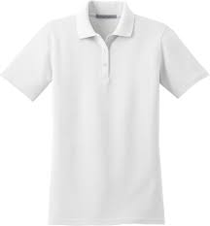
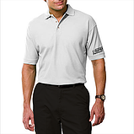

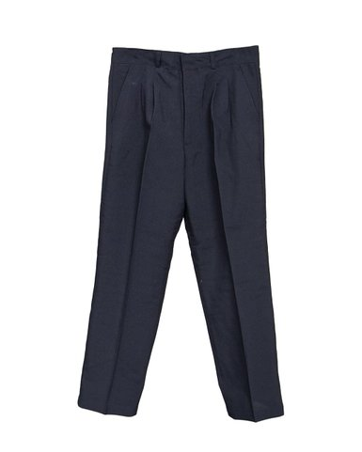
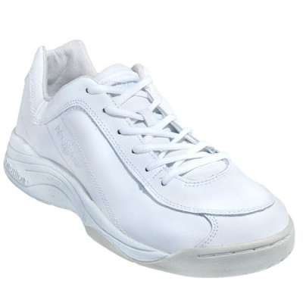
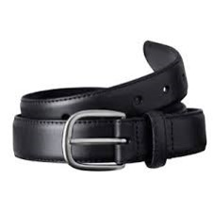
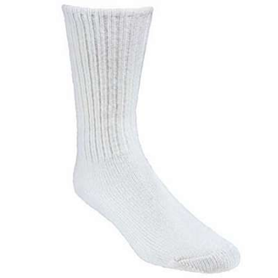
Appropriate OHSBVA Referee Uniform Items
Notes:
For our new and newer referees, this slide shows examples of proper OHSBVA uniform items for officials: pictured clockwise from the upper left are a white officiating shirt, a white shirt with Certified Official logo on the sleeve, the logo itself, a black belt, white socks, white shoes and black slacks.
42

Slide 43
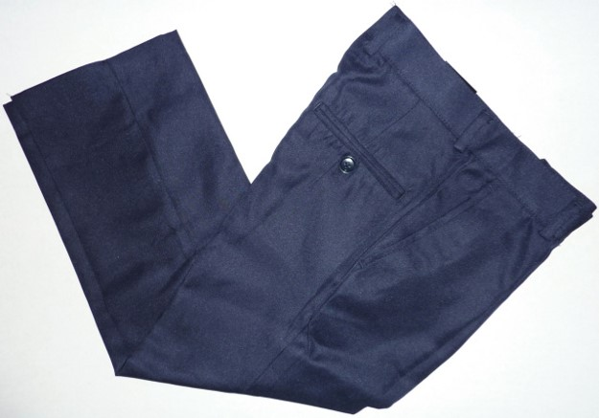
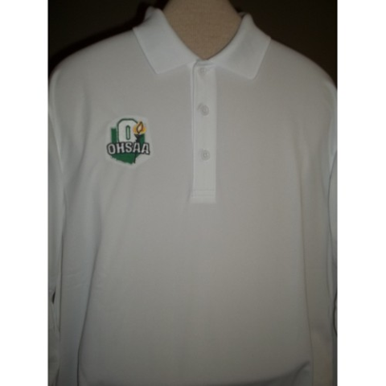
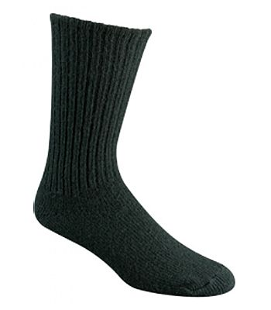
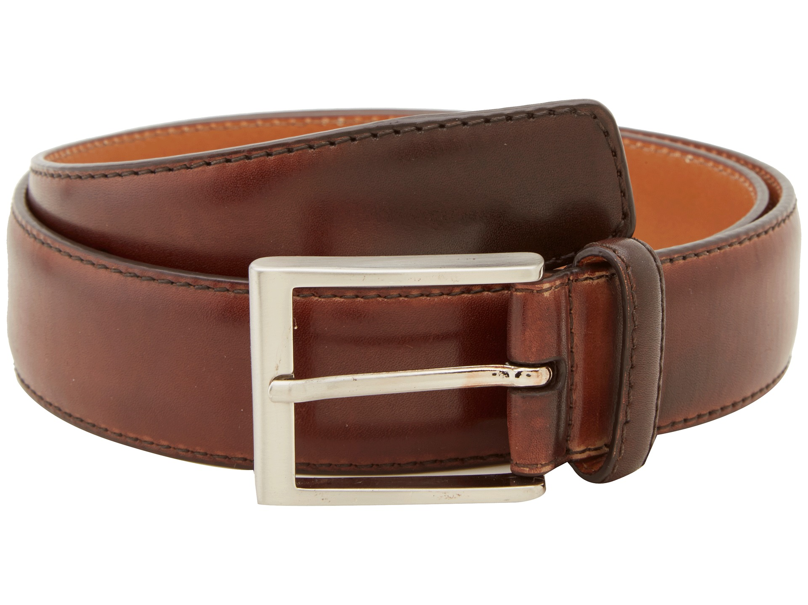
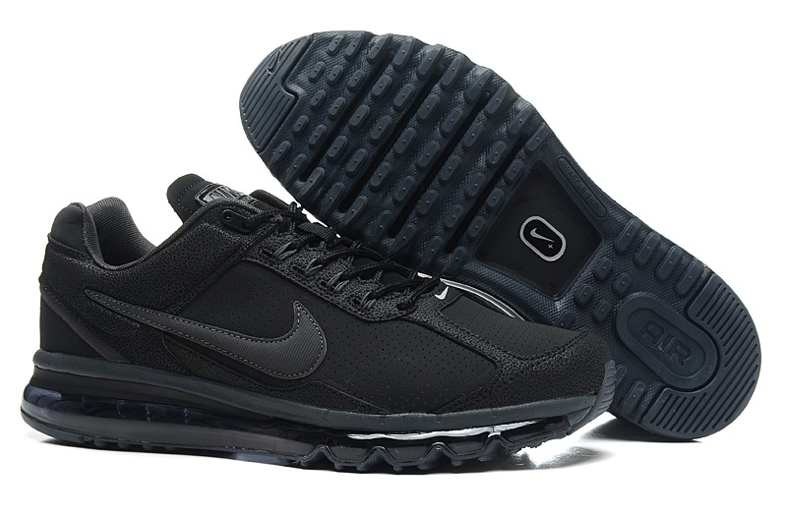
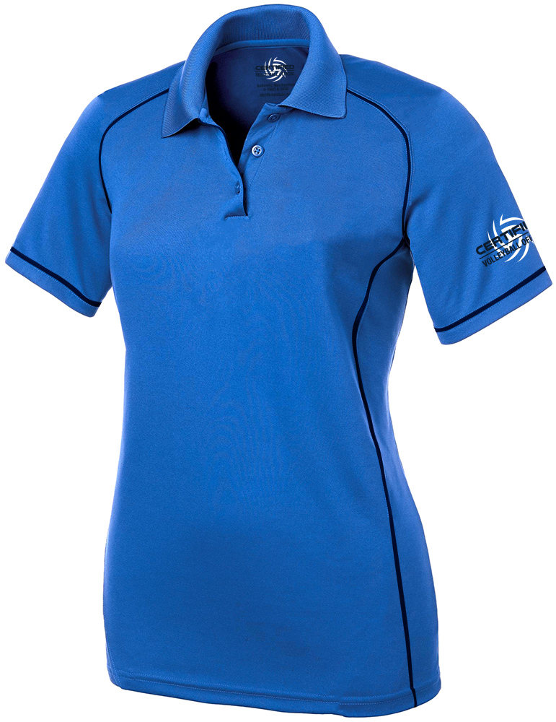
“Inappropriate” Referee Uniform Items
Notes:
Pictured clockwise from upper to left on this slide are referee items that should not be worn: an OHSAA shirt without the OHSBVA patch covering the OHSAA logo, black/blue/dark socks as opposed to white socks, blue slacks, a blue short-sleeve Volleyball Certified Official’s shirt, a brown (non-black) belt and black (non-white) athletic shoes.
43

Slide 44
Breakout Sessions
            Video reviews: challenging plays
            Tracking rotations: back-row and overlap awareness
Notes:
These video clips will show challenging plays in terms of what was called or not called and what the group believes should have been called or not called.
Tracking rotations is a key to judging possible back-row faults as well as determining whether there are overlaps that need to be warned or whistled.
44

